Slide 1
MATCHING VISUALIZATIONS TO DATA
Notes:
”Numbers don’t lie”
Feel free to take notes on your favourites
Think about the type of data you work with and what would be useful
Data story teller
Tool box
Fundamental considerations: relationship, type
Guiding principles: signal to noise, broad vs focussed

Slide 2
Matching Visualizations to Data
With data displays, we try to highlight:
a relationship – show a connection or correlation between two or more variables, such as the impact of an aging population on health care;
a comparison – set some variables apart from others, and display how those two variables interact, or merely differ, such as the number of fans attending hockey games for different teams in a season;
a composition – collect different types of information that make up a whole and display them together, such as the various search terms that visitors used to land on your site, or how many visitors came from various sources (links, search engines, or direct traffic), and
a distribution – lay out a collection of related or unrelated information to see how it correlates (if at all), and to understand if there's any interaction between the variables, such as the number of bugs reported during each month after a new software release. Also possible to look at just one variable.

Slide 3
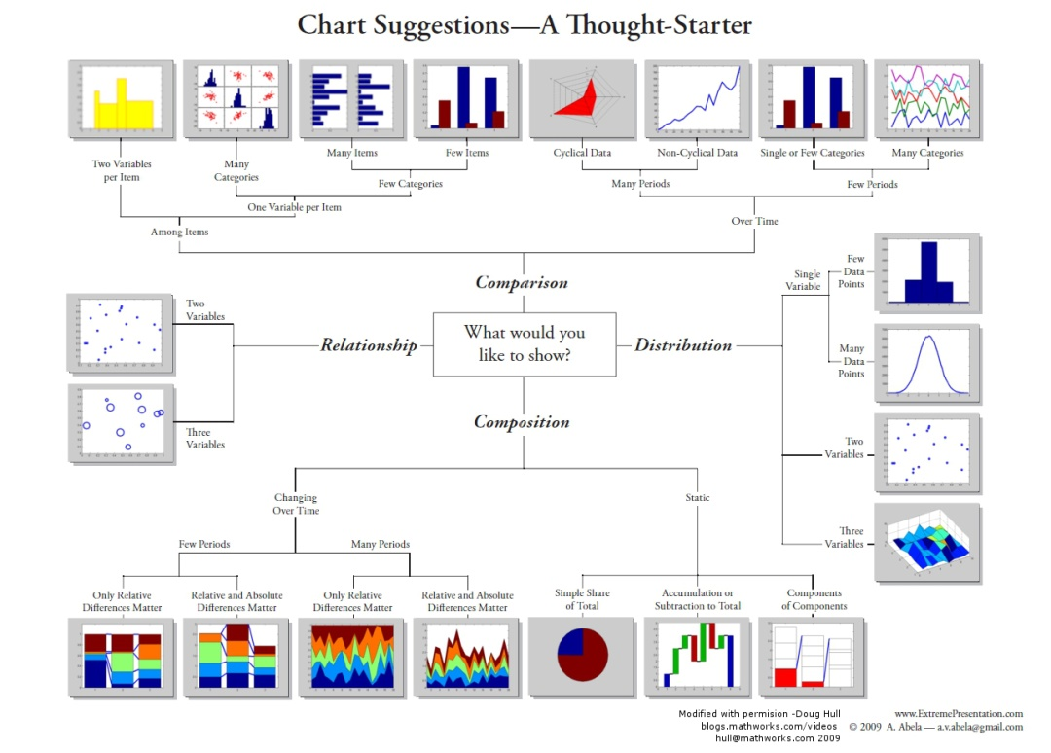
Matching visualizations to data
Notes:
A way to represent a mental map, but not THE way
There is another consideration (data type) we will get to later

Slide 4
VISUALIZATION CATALOGUE

Slide 5
Workhorse Data Visualizations
Line Chart/Rug Chart/Number Line (data exploration)
Histogram (data exploration)
Boxplots (data exploration)
Line Graph (data presentation + data exploration)
Bar Chart (data presentation + data exploration)
Scatterplot (data presentation + data exploration)

Slide 6
Simple Text
One or two numbers to focus on.
Good at “setting the scene”.
Draws focus to an area of the report.
95% of the population
drinks tea today compared to
75% in 2007

Slide 7
Table
Tables interact with our verbal system, which means we read them:
used to compare values
audiences will look for their rows
Table design needs to blend into background
the data should stand out, not the borders
dense table/data: use alternating row colour
Name | Last Year | This Year
Bob | 20 | 30
Fred | 30 | 40
George | 10 | 15
Name |  | Last Year | This Year
Bob |  | 20 | 30
Fred |  | 30 | 40
George |  | 10 | 15
Notes:
Broad vs narrow (more flexibility but different meanings)
Using element (colour) to boost signal

Slide 8
Table Heatmap
Leverage colour to convey magnitude
use single colour saturation rather than differentiation (different colours)
with a legend (white = low, blue = high), numbers can be removed without altering the message
Notes:
Adding elements to boost signal

Slide 9
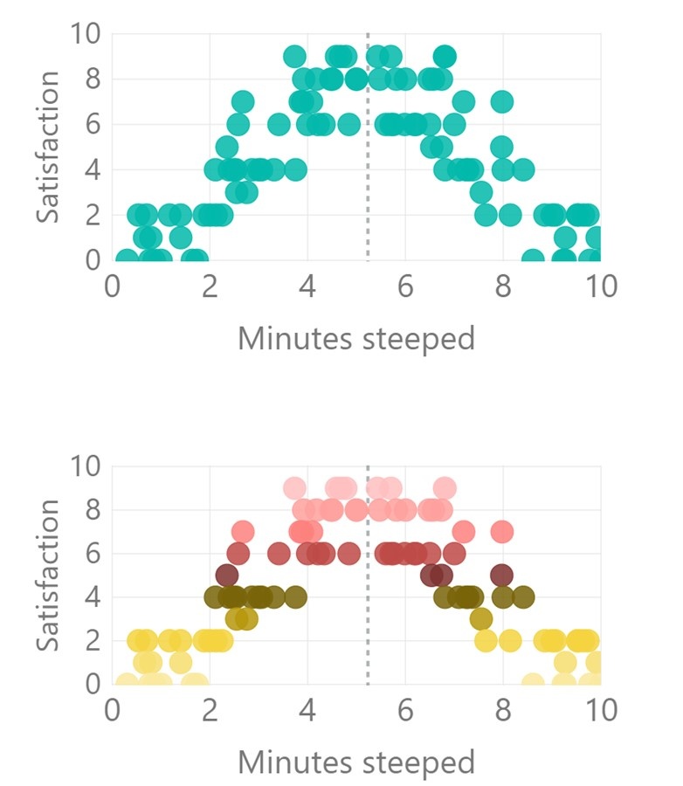
Scatterplot
How long should the perfect cup of tea be steeped?
Show relationship between 2 variables (scatterplot) or 3 variables (bubble plot)
use average lines (dotted lines) to provide context
far fewer options in Power BI than Excel
consider using groupings to add clarity (e.g. colour gradients)
Notes:
Workhorse
Distribution and relation
Continuous, Categorical
Beginning to add elements to boost signal
Bridging into small multiples

Slide 10
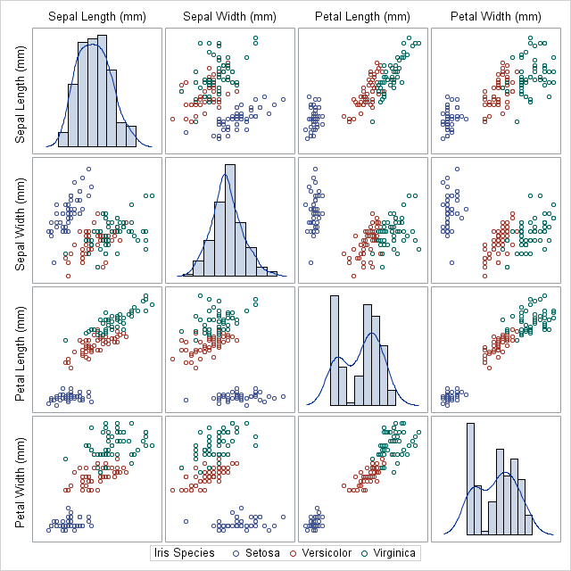
[Created using SAS proc sgscatter]
Notes:
Small multiples
Veering to represent the abstract concept of adding elements to boost signal

Slide 11
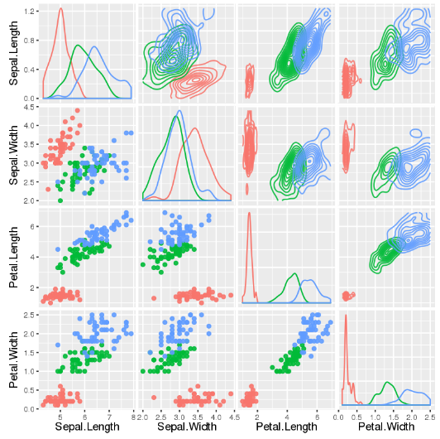
[Created using R’s ggpairs()]

Slide 12
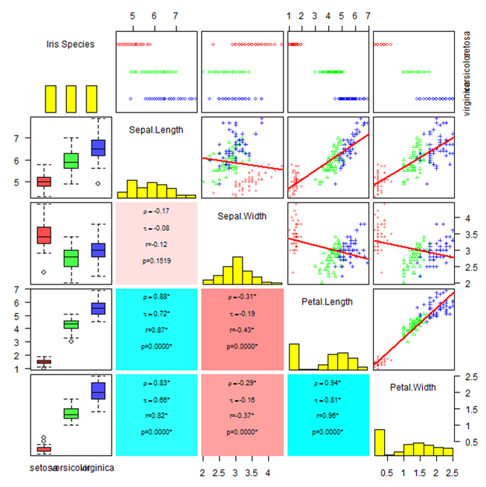
[Author unknown, found online]
Is this starting to get too cluttered?
Notes:
Think about this slide when you are creating your dashboards tomorrow

Slide 13
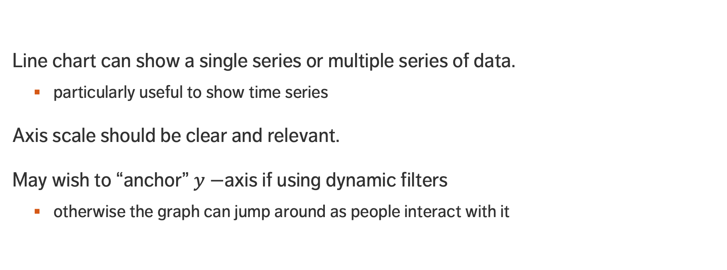
Line Chart
Line chart can show a single series or multiple series of data.
particularly useful to show time series
Axis scale should be clear and relevant.
May wish to “anchor” $y−$axis if using dynamic filters
otherwise the graph can jump around as people interact with it

Slide 14
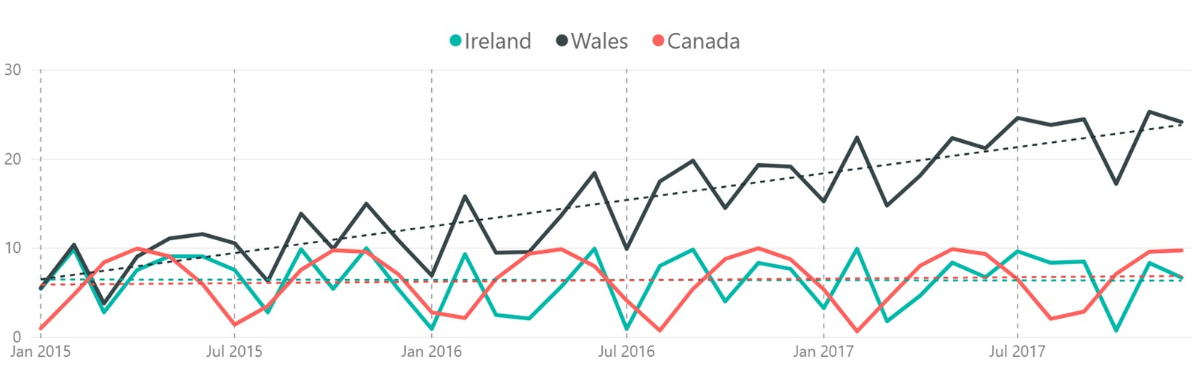
Line Chart
Comparison of Countries – cups of tea drunk per week per person

Slide 15
Bar Chart (Vertical & Horizontal)
Very versatile and useful.
ALWAYS (?) have a zero baseline.
Use graph axis OR data labels. Axis for broad statements, data labels for more detail.
Horizontal charts are apparently easier to read (according to many studies).
Think about the ordering of categories.
Notes:
Dashboard tomorrow
Get opinions
Ordering of categories

Slide 16
STACKED Bar Chart (Vertical & Horizontal)
Designed for comparing totals, but can quickly become overwhelming.
Hard to sort / order.
Filtering is complicated in Power BI (what do you click on & how the chart responds when filter is clicked on?)
Notes:
Adds another categorical variable into the mix
Tempting because it saves on real estate, but clutter?
Hard to determine order
Can be a little finicky in Power BI with filters stacking on one another

Slide 17
100% Bar Chart (Vertical & Horizontal)
Work well for visualizing portions of a whole on scale from negative to positive
Consistent baseline on far left and right
Easy to compare
Issue is no relative measure to magnitude of data
Research shows that horizonal is easier to process than vertical
Notes:
Proportions rather than total counts, but can add those
Use cases? Division of effort management
Will you be present to explain your dashboard? Some viz’s stand alone, some need help.
Keep in mind the workhorses – we have also been showing show ponies.

Slide 18
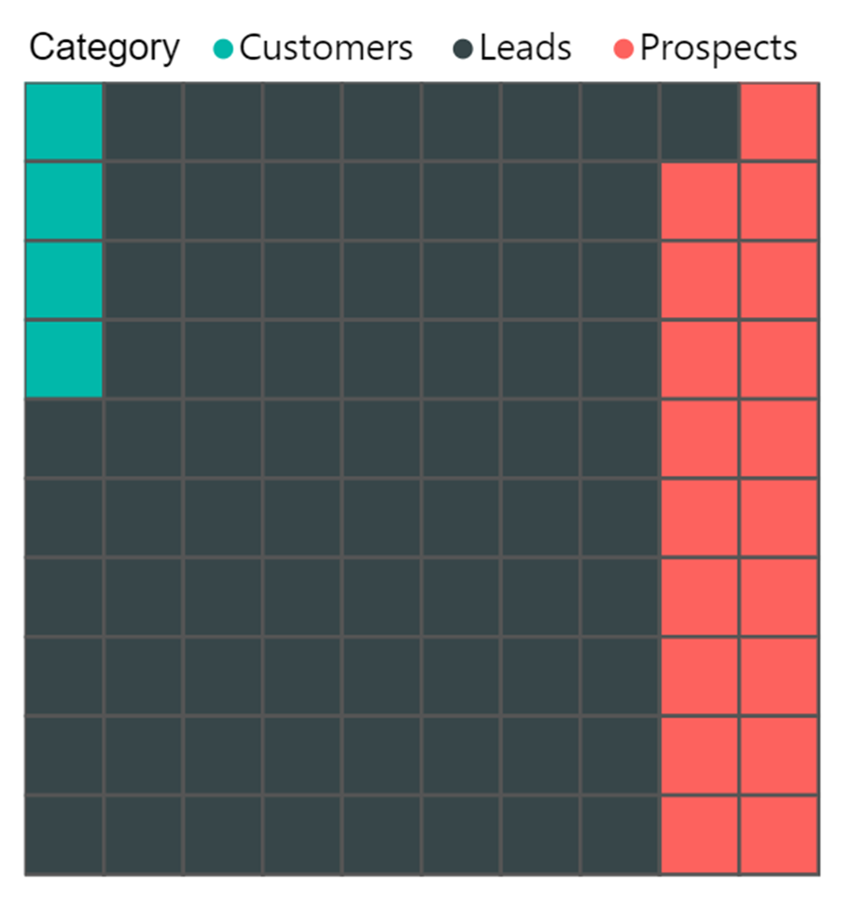
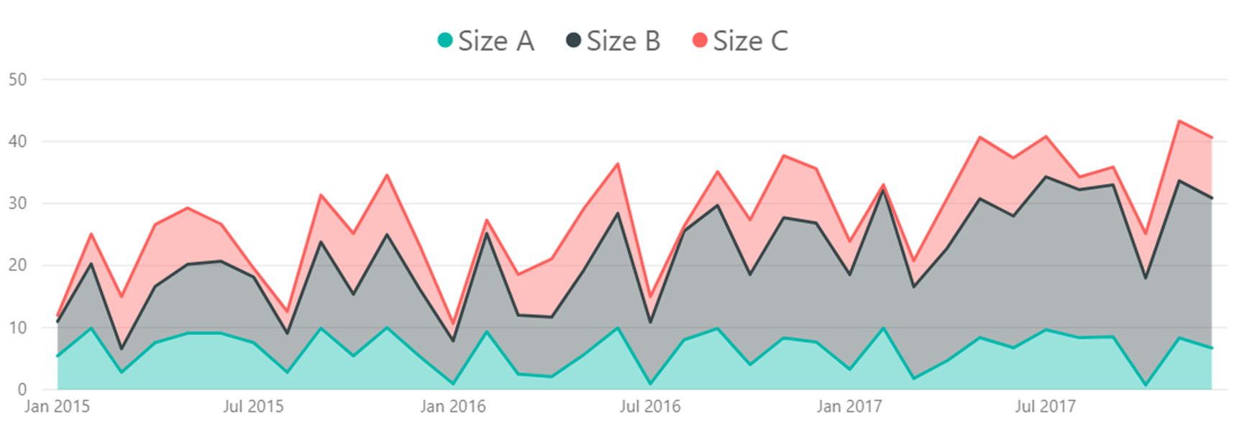
Area Chart
Try to avoid: human brains have a hard time attributing a value to a 2D area…
… except for numbers with vastly different magnitudes.
Notes:
Generally bad
Use cases left: seating
Right: Covid and optical illusion, c’s volatility makes b’s volatility look more intense

Slide 19

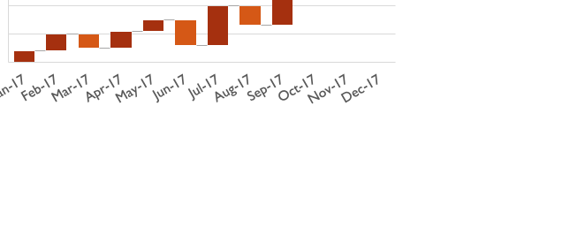
Waterfall
Shows how initial value increases or decreases using a series of intermediate values.
Different colours can be used for increases and decreases.
Hard to remove elements without removing context (hard to declutter the chart).
Large increases / decreases look odd…
Number of Units Sold
Notes:
Anyone seen one of these?
Variation around a set point
Gains losses, stocks

Slide 20
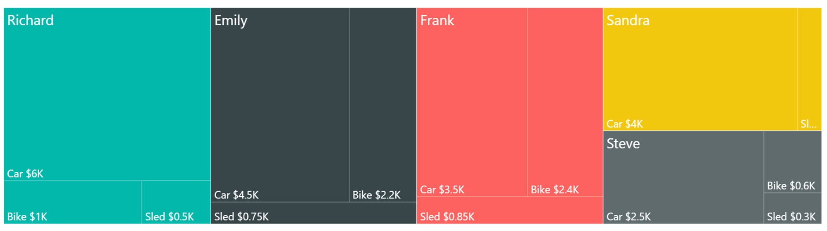
Treemap
Simultaneously show big picture and can compare related easily.
Easy to process data sub-categories.
Useful to prioritize “big ticket items” in dynamic dashboards.
Labeling and colouring are tricky.
Notes:
Little known but growing in popularity
Sometimes requires a little framing for people at first
Takes up a lot of room though
How does one choose colours? Teamwork, AI suggestions

Slide 21
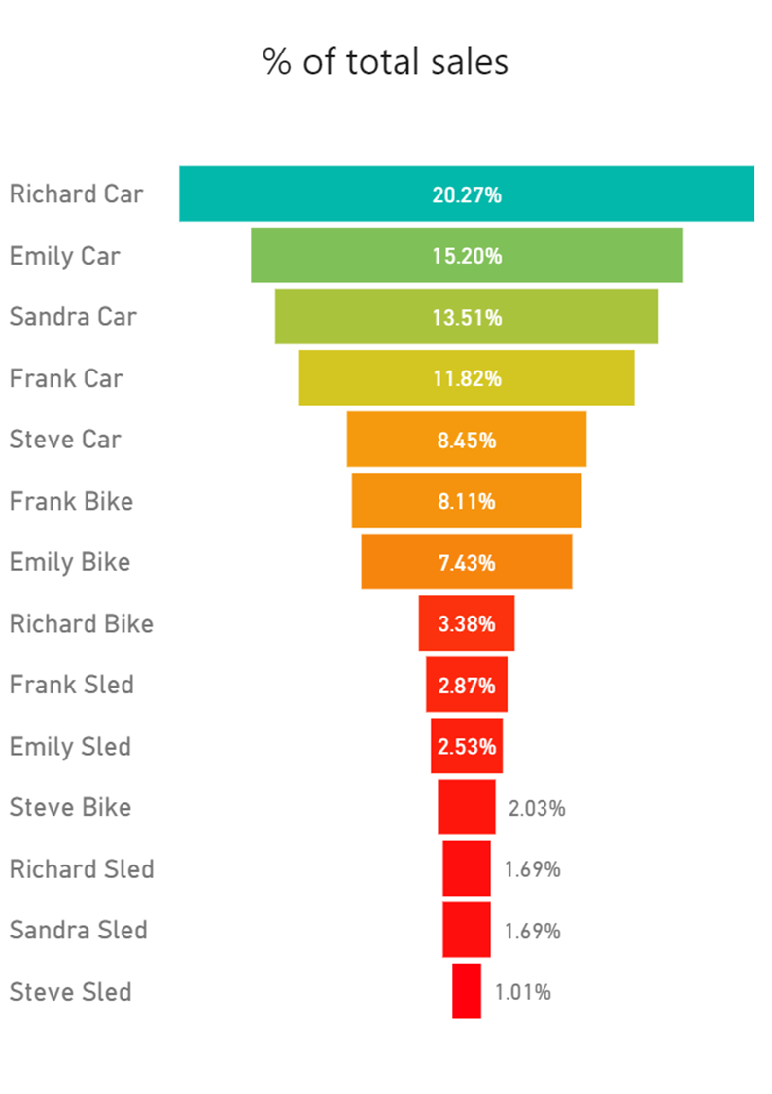
Funnel CHART
Typically represents decreasing proportions amounting to 100% total (not always though).
Power BI does not default sort, so users should ALWAYS sort from high to low (otherwise, plot looks messy).
VERY useful to help audience quickly prioritize items without having to actively filter.
Notes:
NEXT 3 ARE VARIATION ON THE BAR CHART
Sorting required in advance
Nice overall impression, comparison relating to proportions rather than raw values

Slide 22
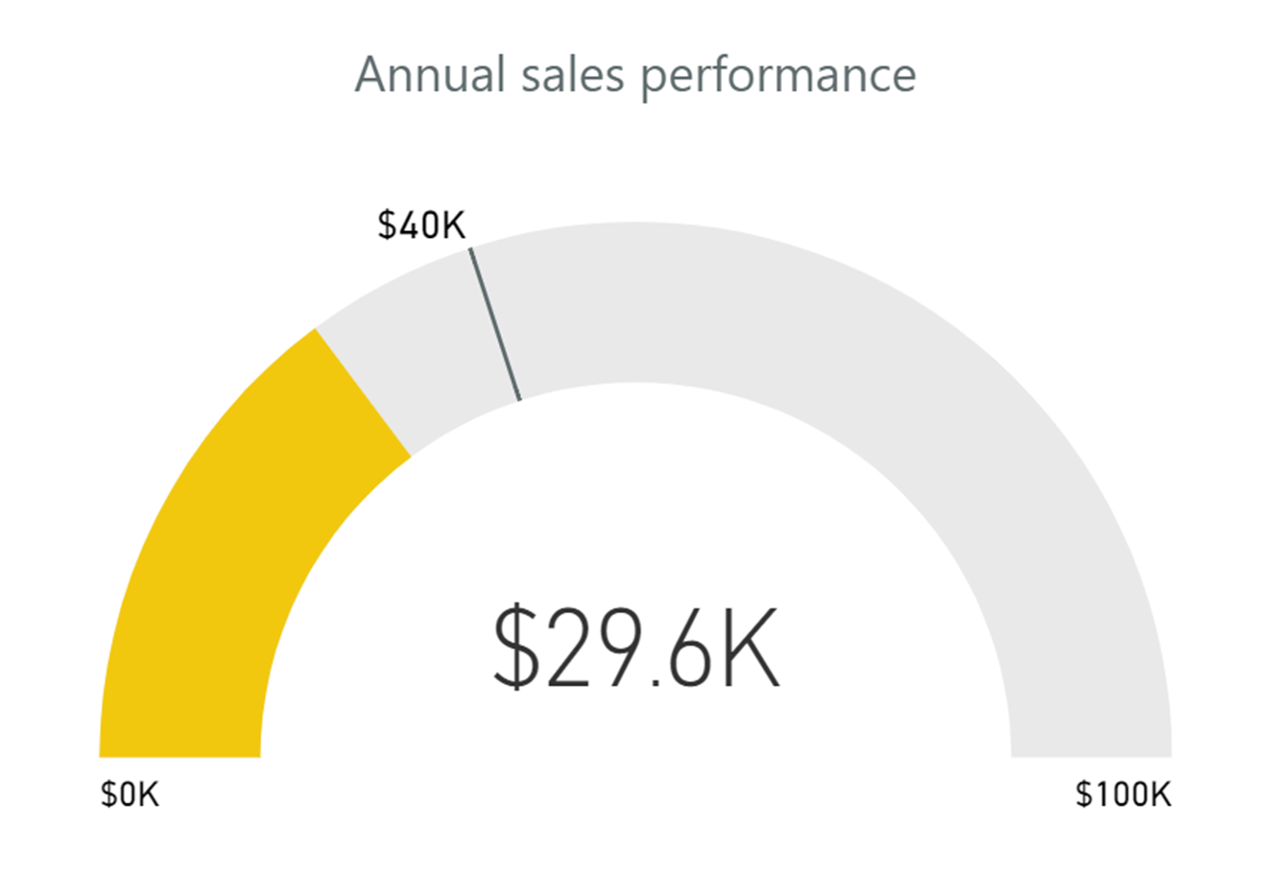
GaUge
Often used as a dashboard component (with or without needle).
Displays single value measures towards goal / KPI.
Great to show progress (a bit of a management fad, though…)
Displays information that can be quickly scanned and understood.
Notes:
A little like plain text
Fun gamification vibe – target and desire to fulfill
Powerful when combined with text
Standalone

Slide 23
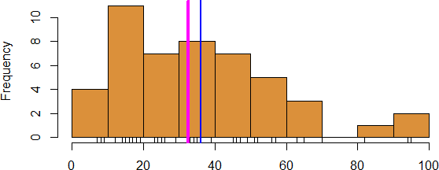
Histograms
[Personal file]
0 2 4 6 8 10
Frequency
0 20 40 60 80 100
Reported work hours (1 specific week)

Slide 24
Histograms
Pros:
known by many non-technical individuals
easy to read (looks like something right out of high-school)
can be adorned with added information (median, mean, hairs, etc.)
Cons:
somewhat depressingly, a vast majority of the population does not know how to read them… yet it’s conceivably one of the simplest graphical representations.

Slide 25
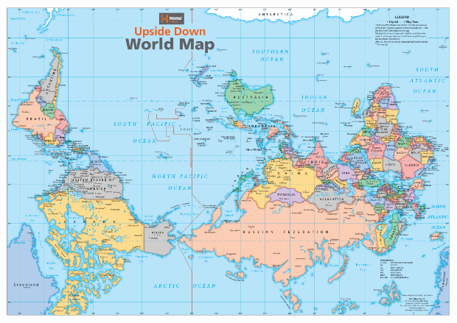
Maps
[Upside Down Maps]
Most of us are quite familiar with geographical maps, so they tend to be easier to interpret.
Can produce a striking effect when the data visualization shows un-expected results
which may mask significant information
or lack of significant information
or change the way you view things

Slide 26
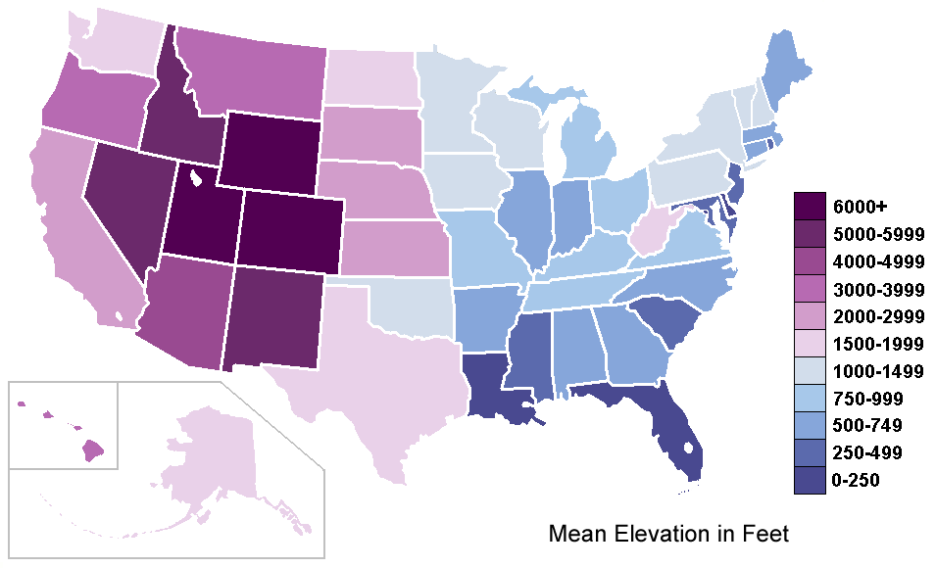
Heat Maps (Choropleths)
[Author unknown]
Mean Elevation in Feet (by U.S. State)

Slide 27
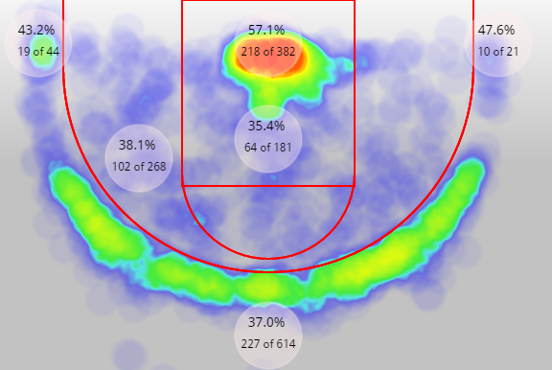
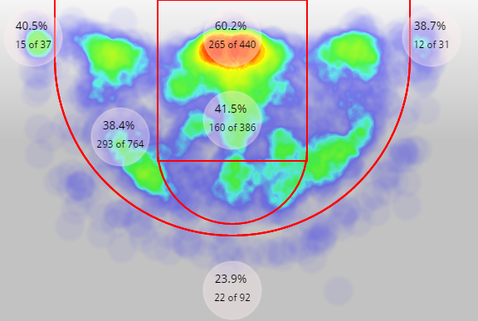
Heat Maps
[NBAsavant.com]
NBA FG% (2015-16)
Kyle Lowry
DeMar DeRozan

Slide 28
Heat Maps
Ideal to look at the relationship between 3 or 4 variables
if one of them represents a percentage or a value within a set range (in order to fix the colour scale, for comparison purposes)
and the other can act as categorical variables / size variables
Better to bin the data, even if the axes variables are continuous (decreases the number of required observations for usefulness)
Easier to read if colours are selected along natural colour gradients, such as
Red → Green or Red → Yellow → Green
for instance (but that’s not ideal if colour blind)

Slide 29
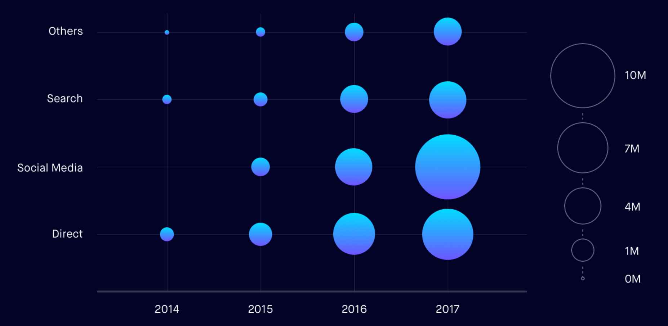
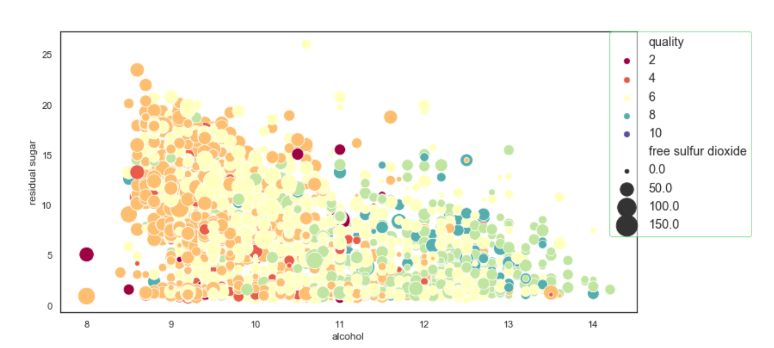
Bubble Charts
Website Traffic from Different Channels Over a Four-Year Period
Wine Quality Relative to Three Factors
from: https://medium.muz.li/guide-to-data-visualization-comparison-part-1-678382ceef00
from: https://towardsdatascience.com/bubble-charts-why-how-f96d2c86d167

Slide 30
Bubble Charts
Colour + geometry allow us to plot (at least) 2 extra variables on a 2D scatter plot
May need to re-scale or bin the available data
A movie could be used to visualize an additional ordinal variable
Text can also be added to visualize an additional categorical variable
Works best when chart is not too encumbered
A personal favourite – a good mixture of traditional and modern features

Slide 31
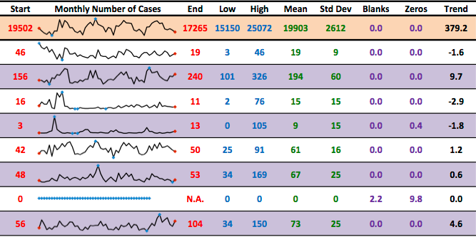
SPARKLINES and Small Multiples
[Personal file]
TOTAL
Hospital #1
Hospital #2
Hospital #3
Hospital #4
Hospital #5
Hospital #6
Hospital #7
Hospital #8
…
Notes:
This uses small multiples,
easy to digest chart (map)
People bring context to it
Because of subject matter has potential to tell really interesting story
This doesn't mean its perfect
Take a look at this and tell me what you think.

Slide 32
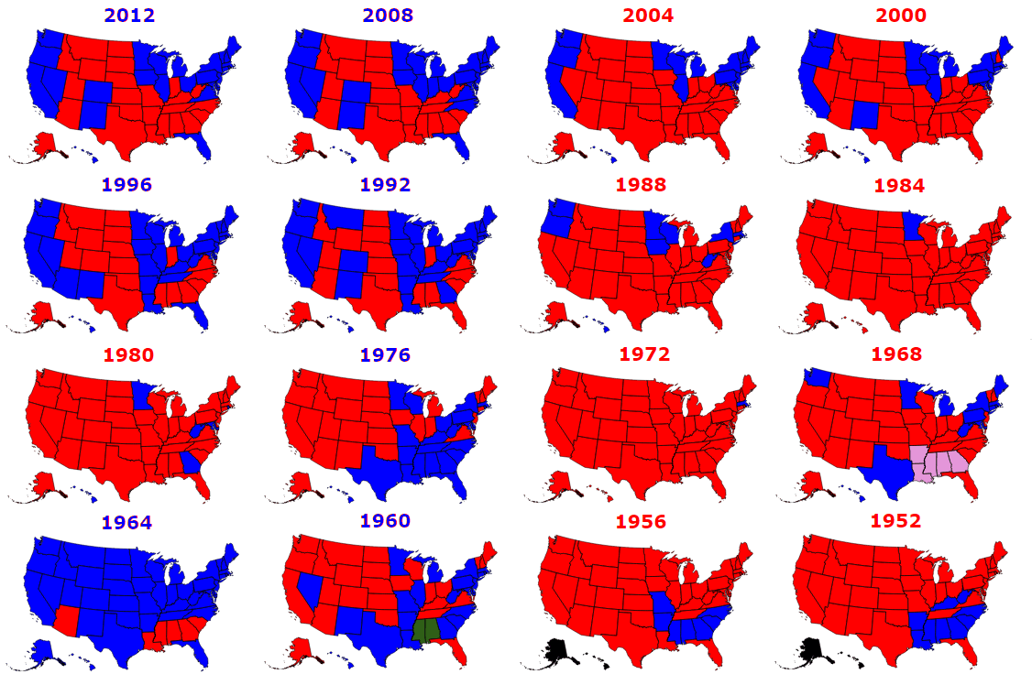
Small Multiples
[Metrocosm.com]
U.S. Electoral College Results 1952 – 2012

Slide 33
Charts to avoid
ANYTHING with an arc (except gauge)
pie
donut
Brains cannot compare arcs so they can be misleading: without labels, how easy is it to compare Steve & Bob?
ALL 3D IS EVIL!
as with arcs, we cannot easily visually compare data series
adds way too much clutter

Slide 34
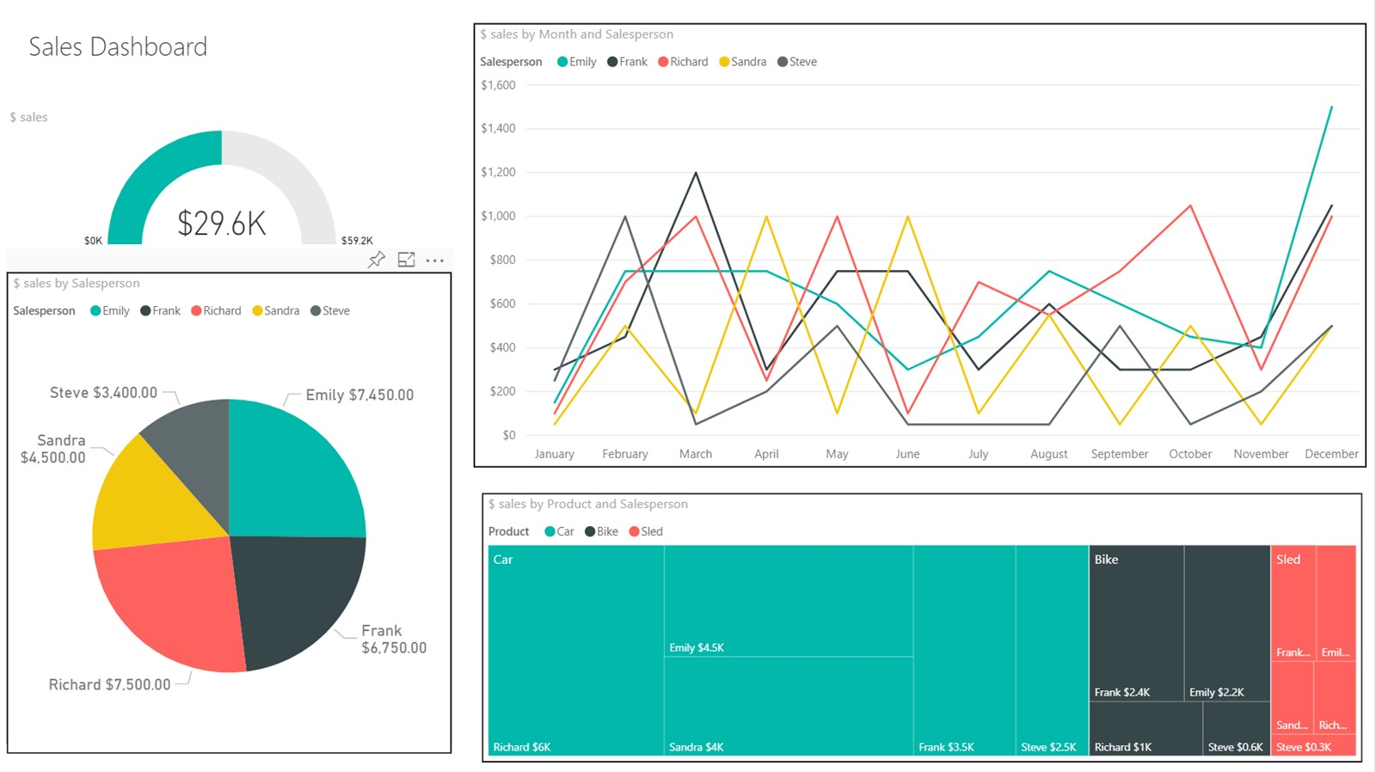

Slide 35
